Slide 1







STACK OVERFLOW DEVELOPER SURVEY
NAME: HAMMAD SIDDIQUI
DATE: 17/05/2024

Slide 2



OUTLINE
Executive Summary
Introduction
Methodology
Results
Visualization – Charts
Dashboard
Discussion
Findings & Implications
Conclusion
Appendix

Slide 3

EXECUTIVE SUMMARY
Data contextualization and their analysis was the goal.
Methodology description:
Data gathering is done
Effective data analysis is made
Data visualizations
Results are presented and supported with graphs and trends.
Discussion on overall findings is made and implications of previously exposed result is also discussed.
Final conclusion of carried out project is made.

Slide 4

INTRODUCTION
Stack overflow's annual developer survey is one of the largest and most comprehensive survey of people who code around the world.
There are many new technologies coming up daily in different demographics of the world.
Results don’t even represent everyone in the developer community evenly. Characterization of developers around the globe is also seen.
Two forms of data is used for the stack developers survey:
Survey_data_technologies_normalised.csv
Survey_data_demographics.csv

Slide 5

METHODOLOGY
Collection of survey data and exploration of its content is made:
Web scrapping
APIs
Request Library
Data wrangling
Exploratory data analysis
Analyzing data distribution
Handling outliers
Correlations
Data visualizations
Highlight distribution of data, relationships, the composition and comparison of data
Dashboards

Slide 6

RESULTS

Slide 7
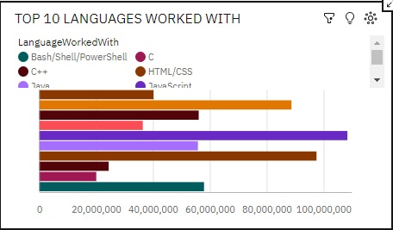
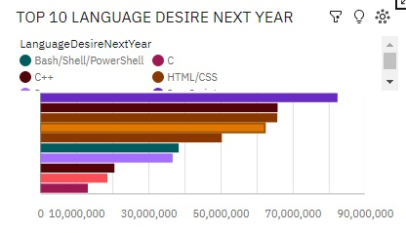
RESULT (1.PROGRAMMING LANGUAGE TRENDS)
Current Year
Next Year

Slide 8
PROGRAMMING LANGUAGE TRENDS - FINDINGS & IMPLICATIONS
Findings
JavaScript seems to keep as leading language.
Python fastest growing language.
Greatest interest in Typescript.
Implications
Possible developers migration from JavaScript to Typescript and python is seen.
Even large chunks of developers are showing interest in HTML/CSS and SQL too.
There is decline of interest in C language is shown.

Slide 9
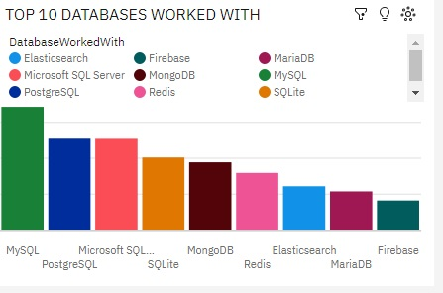
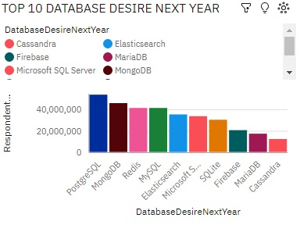
2.DATABASE TRENDS
Current Year
Next Year

Slide 10
DATABASE TRENDS - FINDINGS & IMPLICATIONS
Findings
As seen from dashboard chart MySQL is used most as database.
Lack of interest in Microsoft SQL server and SQLite is seen.
Increasing interest in MongoDB and PostgreSQL.
Implications
Microsoft SQL server and SQLite are losing ground in the market.
There is a hype and excitement among developers for MongoDB and PostgreSQL.
MariaDB and Firebase database have lesser impact among developers both in current and in next year trends.

Slide 11
DASHBOARD
https://github.com/siddhamd/HAMMAD-

Slide 12
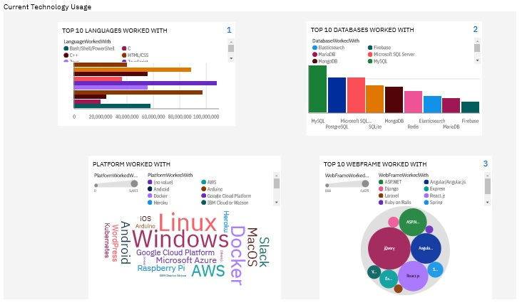
DASHBOARD TAB 1 (CURRENT TECHNOLOGY USAGE)

Slide 13
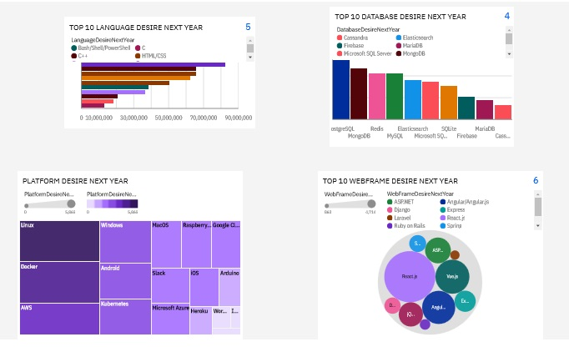
DASHBOARD TAB 2(FUTURE TECHNOLOGY TREND)

Slide 14
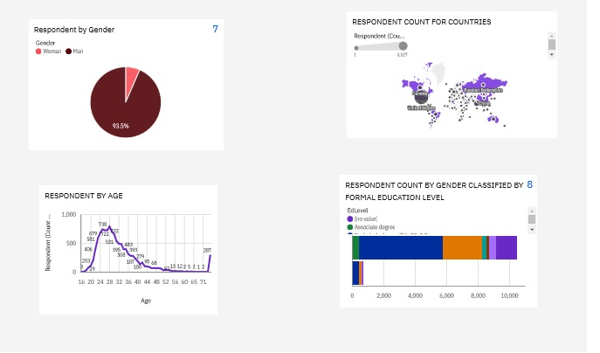
DASHBOARD TAB 3(DEMOGRAPHICS)

Slide 15
DISCUSSION
As all the findings regarding given data in the course is followed through.
Data is wrangled in order to remove duplicates and analyzed accordingly.
Proper visualization in online IBM Cognos analytics is done in order to make dashboards.
Proper findings from the report is made and implications are drawn out.

Slide 16
OVERALL FINDINGS & IMPLICATIONS
Findings
JavaScript is widely used as per given data and Typescript is getting popularity.
As in demographics I have found out there are more than 90% male developers.
Developers are mostly located in developed countries.
Implications
JavaScript and Typescript are in demand in the market ground.
Global polarization of developers location and gender.
Young developers without postgrad studies on its majority.

Slide 17

CONCLUSION
Developers are the ones who are building every scaling of companies as they have very marked characteristics.
I have found out people are very keen on new technologies coming out.
As there are many tools in form of different languages, databases and Web-frames and good idea of popularity trend is seen.
There is a job opportunity for many who are keen to learn new things as many developed countries are wide spreading their job access to many across globes.

Slide 18

APPENDIX
I have attached three screenshots of the work I have completed in previous module in form of Box-plot, Bar-Chart in order to showcase the authenticity of the capstone project of data analyst.
As data in this project are taken from IBM repository provided by course era in this particular data analyst course, based on which presentation is made.

Slide 19
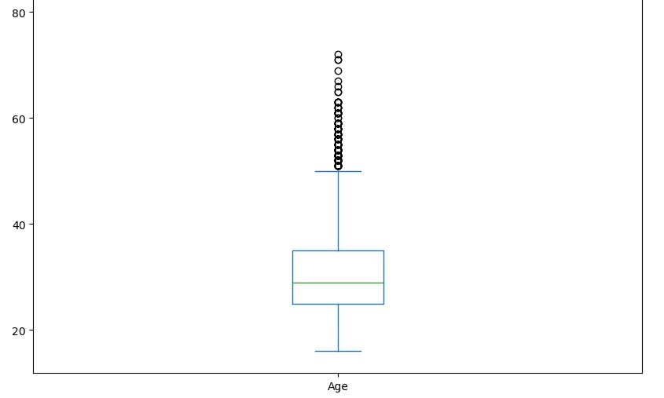
AGE DISTRIBUTION BOXPLOT

Slide 20
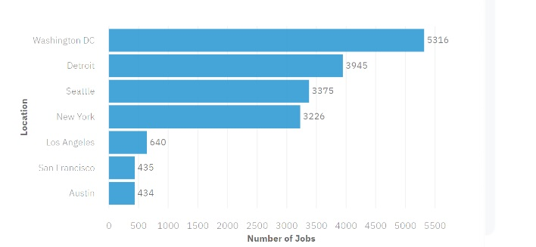
JOB POSTINGS

Slide 21
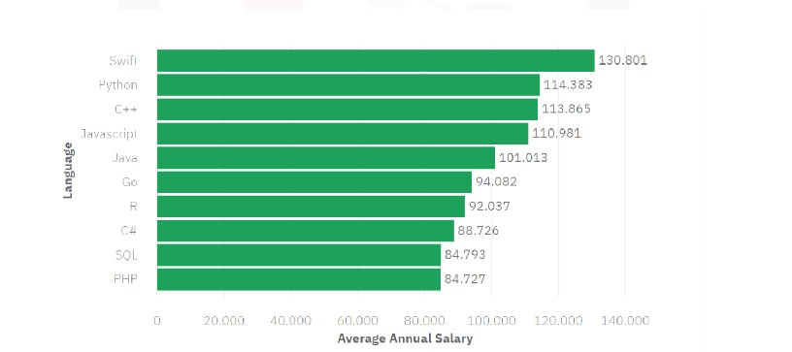
POPULAR LANGUAGES

Slide 22
THANKING YOU.

